Slide 1
Webinar 4
Gut Supplements

Slide 2
Overview
Digestive enzymes
L Glutamine
Zinc Carnosine
Betaine Hydrochloride
Prebiotics, probiotics, synbiotics, fermented food
ACV
Ginger

Slide 3
Digestive Enzymes
Exocrine pancreatic insufficiency (EPI)
Symptoms
Bloating
Pain abdomen
Diarrhea
Loose, greasy, bad-smelling stools
Flatulence
Weight loss
Rarely, low bone mass

Slide 4
Causes Of Exocrine Pancreatic Insufficiency (EPI)
Chronic and acute pancreatitis
Cystic fibrosis
Pancreatic cancer
Diabetes—types 1 and 2
Untreated celiac disease
Inflammatory bowel disease
Zollinger-Ellison syndrome
Porcine lipase 25,000-40,000 units
per meal.

Slide 5
Roxas, Mario. "The role of enzyme supplementation in digestive disorders." Alternative medicine review 13.4 (2008).

Slide 6
Glutamine
Glutamine, an amino acid is a major substrate utilized by intestinal cells.
Helps with maintaining intestinal barrier function, modulation of inflammation, and regulating stress responses and apoptosis.
Plasma levels of glutamine do not reflect tissue levels.
Kim, Min-Hyun, and Hyeyoung Kim. "The roles of glutamine in the intestine and its implication in intestinal diseases." International journal of molecular sciences 18.5 (2017): 1051.

Slide 7
Glutamine in IBS
5 grams of glutamine 3 times a day in patients with post infectious IBS-D
The primary end point was a reduction of ≥50 points on the Irritable Bowel Syndrome Severity Scoring System (IBS-SS).
43 of 54 patients (79.6%) in the glutamine group had a reduction of 50 points or more vs. 3 of 52 (5.8%) in the placebo group.
Zhou, QiQi, et al. "Randomised placebo-controlled trial of dietary glutamine supplements for postinfectious irritable bowel syndrome." Gut (2018): gutjnl-2017.
Notes:
Powdered

Slide 8
Zinc Carnosine (Polaprezinc)
Gastric mucosal protective agent
Improves the eradication rates of Helicobacter Pylori
Has antioxidant and antiapoptotic effects
Reduces inflammation
Promotes the healing of peptic ulcers and improve the quality of ulcer healing.
Dosage Total 150 mg of Zinc Carnosine in 2-3 divided doses. At least 8 weeks. Provides 32 mg of Zn. (Zn and Cu need to remain in balance)
Li, Mingru, et al. "Recent advances on polaprezinc for medical use." Experimental and Therapeutic Medicine 22.6 (2021): 1-7.

Slide 9
Low Stomach Acid
Condition | Gastric pH
Normal | Less than 3
Hypochlorhydria | Greater than 3
Achlorhydria | Greater than 7
People on proton-pump inhibitors | 5-7
Guilliams, Thomas G., and Lindsey E. Drake. "Meal-Time Supplementation with Betaine HCl for Functional Hypochlorhydria: What is the Evidence?." Integrative Medicine: A Clinician's Journal 19.1 (2020): 32.
Notes:
Difficulty measuring gastric pH

Slide 10
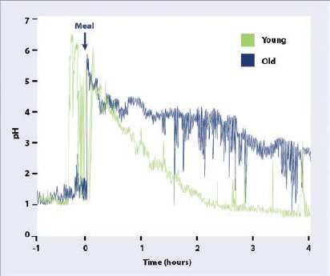
Causes of Low Stomach Acid
Age. Takes longer to reach baseline.
PPI use
H. Pylori infection
Pernicious anaemia
Gastric bypass
Guilliams, Thomas G., and Lindsey E. Drake. "Meal-Time Supplementation with Betaine HCl for Functional Hypochlorhydria: What is the Evidence?." Integrative Medicine: A Clinician's Journal 19.1 (2020): 32.
Smolka, Adam J., and Mitchell L. Schubert. "Helicobacter pylori-induced changes in gastric acid secretion and upper gastrointestinal disease." Molecular pathogenesis and signal transduction by helicobacter pylori (2017): 227-252.

Slide 11
Consequences of Low Stomach Acid
Poor protein digestion
Reduced absorption of micronutrients such as calcium, iron, folic acid, vitamin B6 and vitamin B₁₂.
Can increase the risk for small intestinal bacterial overgrowth (SIBO) and overgrowth of organisms like Clostridium Difficile
Guilliams, Thomas G., and Lindsey E. Drake. "Meal-Time Supplementation with Betaine HCl for Functional Hypochlorhydria: What is the Evidence?." Integrative Medicine: A Clinician's Journal 19.1 (2020): 32.

Slide 12
Gastric Re-acidification with Betaine HCl
Six healthy volunteers (25-57 years) with baseline normal gastric pH
Hypochlorhydria was induced with 20 mg oral rabeprazole twice daily for four days.
On the fifth day, an additional 20 mg dose of oral rabeprazole was given and gastric pH was monitored continuously using the Heidelberg pH capsule.
After gastric pH > 4 was confirmed for 15 minutes, 1500 mg of betaine HCl was given orally
Gastric pH was continuously monitored for 2 hours. Betaine HCl significantly lowered gastric pH.
The onset of effect of betaine HCl was rapid, with a mean time to pH < 3 of 6.3 (±4.3) minutes.
Re-acidification period was temporary.
Yago, Marc R., et al. "Gastric reacidification with betaine HCl in healthy volunteers with rabeprazole-induced hypochlorhydria." Molecular pharmaceutics 10.11 (2013): 4032-4037.

Slide 13
Low Stomach Acid And Betaine Hydrochloride
Betaine HCl 1500 mg (750 mg caps x2)
Take 1 to 3 capsules with each meal.
Another method is to gradually keep increasing the number of caps until there is a burning sensation. Then reduce to the level where there is no burning sensation.
If there is a burning sensation or any other side effects, stop taking the supplement.
If there are improvements continue to take betaine HCl.
If there is no improvement in symptoms after two weeks, stop taking the supplement.
Contraindicated in peptic ulcers.
Notes:
Betaine HCl is not betaine (or trimethylglycine (TMG). TMG is methyl donor.

Slide 14
Probiotics, Prebiotics, Synbiotics, Fermented Food

Slide 15
Probiotics
Probiotics are live microorganisms which when administered in adequate amounts confer a health benefit on the host.
Food and Agriculture Organization of the United Nations and the World Health Organization

Slide 16
What Conditions
Challenges with clinical trials.
Prevention of necrotizing enterocolitis in very preterm or very low birth weight infants. Specific strains.
In adults and children on antibiotic treatment.
Specific strains including S boulardii; or the 2-strain combination of L acidophilus CL1285 and L casei LBC80R; or the 3-strain combination of L acidophilus, L delbrueckii subsp bulgaricus, and B bifidum; or the 4-strain combination of L acidophilus, L delbrueckii subsp bulgaricus, B bifidum, and S salivarius subsp thermophilus.
Su, Grace L., et al. "AGA clinical practice guidelines on the role of probiotics in the management of gastrointestinal disorders." Gastroenterology 159.2 (2020): 697-705.

Slide 17
How Do Probiotics Work?

Slide 18
Prebiotics
Prebiotics are food for the gut microbes. Are nondigestible by the host.
Common prebiotics:
Oligofructose (fructooligosaccharide, FOS)
Inulin
Galactooligosaccharides (GOSs)
Lactulose
Breast milk oligosaccharides
Resistant starch
Conjugated linoleic acid
Polyphenols
Guarner, Francisco, et al. "Probiotics and prebiotics." World Gastroenterology Organisation Global Guidelines (2011): 1-28.

Slide 19
Synbiotics
Synbiotics: Mixture comprising live microorganisms and substrate(s) selectively utilized by host microorganisms that confers a health benefit on the host.
Swanson, Kelly S., et al. "The International Scientific Association for Probiotics and Prebiotics (ISAPP) consensus statement on the definition and scope of synbiotics." Nature Reviews Gastroenterology & Hepatology 17.11 (2020): 687-701.

Slide 20
Swanson, Kelly S., et al. "The International Scientific Association for Probiotics and Prebiotics (ISAPP) consensus statement on the definition and scope of synbiotics." Nature Reviews Gastroenterology & Hepatology 17.11 (2020): 687-701.

Slide 21
What about fermented food?
What are fermented food and beverages
Food made through desired microbial growth and enzymatic conversions of food components.
Fermented milk with Lactococcus lactis for 5 weeks lowered blood pressure in prehypertensive people.
Healthy children (aged 12–48 months) consuming daily cow's milk or rice fermented with Lactobacillus paracasei CBA L74 had less common infectious diseases than placebo.
Marco, Maria L., et al. "The International Scientific Association for Probiotics and Prebiotics (ISAPP) consensus statement on fermented foods." Nature Reviews Gastroenterology & Hepatology 18.3 (2021): 196-208.
Beltrán-Barrientos, Lilia M., et al. "Randomized double-blind controlled clinical trial of the blood pressure–lowering effect of fermented milk with Lactococcus lactis: A pilot study." Journal of Dairy Science 101.4 (2018): 2819-2825.
Nocerino, Rita, et al. "Cow's milk and rice fermented with Lactobacillus paracasei CBA L74 prevent infectious diseases in children: a randomized controlled trial." Clinical Nutrition 36.1 (2017): 118-125.

Slide 22
Kefir-fermented Milk and Bone Health
Kefir-fermented milk (1,600 mg) supplemented with calcium bicarbonate (CaCO₃, 1,500 mg) for 6 months in people with osteoporosis improved bone markers.
Tu, Min-Yu, et al. "Short-term effects of kefir-fermented milk consumption on bone mineral density and bone metabolism in a randomized clinical trial of osteoporotic patients." PloS one 10.12 (2015): e0144231.

Slide 23
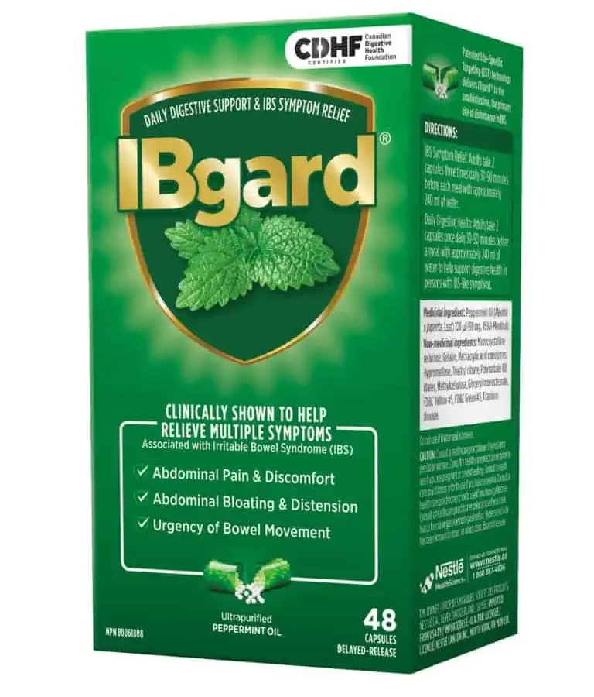
Peppermint Oil (IB Guard)
180 mg three times daily. Controlled release formulation
IBS-D, M scores improved.
Cash, Brooks D., Michael S. Epstein, and Syed M. Shah. "A novel delivery system of peppermint oil is an effective therapy for irritable bowel syndrome symptoms." Digestive diseases and sciences 61 (2016): 560-571.

Slide 24
Herbal therapy compared with Rifaximin in SIBO
Dysbiocide and FC Cidal (Biotics Research Laboratories, Rosenberg, Texas)
Candibactin-AR and Candibactin-BR (Metagenics, Inc, Aliso Viejo, California)
The response rate for normalizing breath hydrogen testing in patients with SIBO was 46% for herbal therapies vs 34% for Rifaximin.
Use cases
Resistant to Rifaximin
Recurrence
Those who don’t want antibiotics
Availability
Cost
Chedid, Victor, et al. "Herbal therapy is equivalent to rifaximin for the treatment of small intestinal bacterial overgrowth." Global advances in health and medicine 3.3 (2014): 16-24.

Slide 25
Apple Cider Vinegar (ACV)
Not much clinical data for gut health. But anecdotal reports there.
May reduce postprandial hyperglycemia
1 tablespoon in a glass of water
ACV tablets available
Stay away from ACV gummies

Slide 26
Ginger
Not much clinical data
Good for pregnancy nausea, chemotherapy nausea
Stay away from candied ginger.

Slide 27
References
Beltrán-Barrientos, Lilia M., et al. "Randomized double-blind controlled clinical trial of the blood pressure–lowering effect of fermented milk with Lactococcus lactis: A pilot study." Journal of Dairy Science 101.4 (2018): 2819-2825.
Cash, Brooks D., Michael S. Epstein, and Syed M. Shah. "A novel delivery system of peppermint oil is an effective therapy for irritable bowel syndrome symptoms." Digestive diseases and sciences 61 (2016): 560-571.
Dressman, Jennifer B., et al. "Upper gastrointestinal (GI) pH in young, healthy men and women." Pharmaceutical research 7 (1990): 756-761.
Guilliams, Thomas G., and Lindsey E. Drake. "Meal-Time Supplementation with Betaine HCl for Functional Hypochlorhydria: What is the Evidence?." Integrative Medicine: A Clinician's Journal 19.1 (2020): 32
Kim, Min-Hyun, and Hyeyoung Kim. "The roles of glutamine in the intestine and its implication in intestinal diseases." International journal of molecular sciences 18.5 (2017): 1051.
Li, Mingru, et al. "Recent advances on polaprezinc for medical use." Experimental and Therapeutic Medicine 22.6 (2021): 1-7.
Marco, Maria L., et al. "The International Scientific Association for Probiotics and Prebiotics (ISAPP) consensus statement on fermented foods." Nature Reviews Gastroenterology & Hepatology 18.3 (2021): 196-208.

Slide 28
References
Nocerino, Rita, et al. "Cow's milk and rice fermented with Lactobacillus paracasei CBA L74 prevent infectious diseases in children: a randomized controlled trial." Clinical Nutrition 36.1 (2017): 118-125.
Roxas, Mario. "The role of enzyme supplementation in digestive disorders." Alternative medicine review 13.4 (2008).
Sharif, Sahar, et al. "Prebiotics to prevent necrotising enterocolitis in very preterm or very low birth weight infants." Cochrane Database of Systematic Reviews 6 (2023)
Smolka, Adam J., and Mitchell L. Schubert. "Helicobacter pylori-induced changes in gastric acid secretion and upper gastrointestinal disease." Molecular pathogenesis and signal transduction by helicobacter pylori (2017): 227-252.
Su, Grace L., et al. "AGA clinical practice guidelines on the role of probiotics in the management of gastrointestinal disorders." Gastroenterology 159.2 (2020): 697-705..
Swanson, Kelly S., et al. "The International Scientific Association for Probiotics and Prebiotics (ISAPP) consensus statement on the definition and scope of synbiotics." Nature Reviews Gastroenterology & Hepatology 17.11 (2020): 687-701.
Tu, Min-Yu, et al. "Short-term effects of kefir-fermented milk consumption on bone mineral density and bone metabolism in a randomized clinical trial of osteoporotic patients." PloS one 10.12 (2015): e0144231.
Yago, Marc R., et al. "Gastric reacidification with betaine HCl in healthy volunteers with rabeprazole-induced hypochlorhydria." Molecular pharmaceutics 10.11 (2013): 4032-4037.
Zhou, QiQi, et al. "Randomised placebo-controlled trial of dietary glutamine supplements for postinfectious irritable bowel syndrome." Gut (2018): gutjnl-2017.

